Slide 1
TomTom Maps API
Jose Jose Rojas & Mateusz Chojnacki

Slide 2
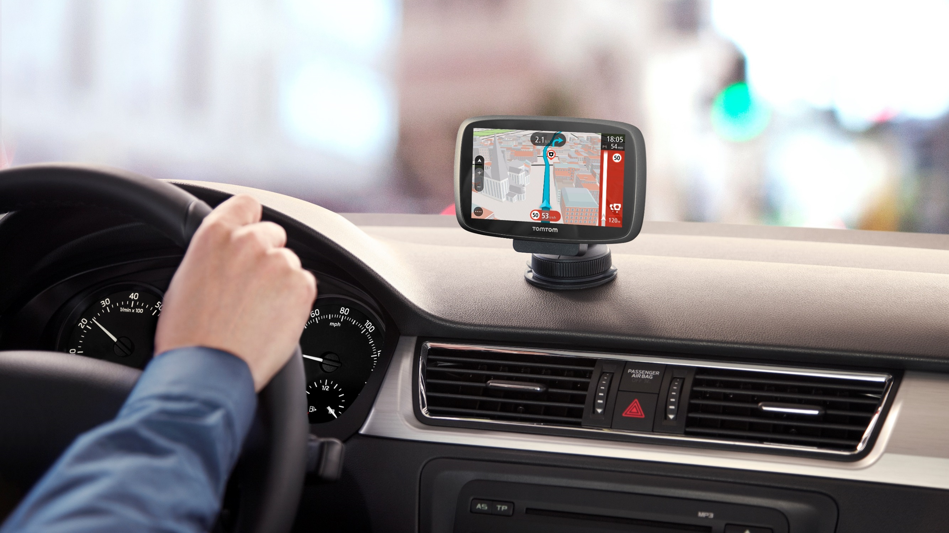
Remember tomtom?

Slide 3
TomTom for developers
Notes:
About 2 years ago we decided to innovate the market by providing access to our APIs to software developer wanting to add Location to their apps. First we created REST APIs to access them, and then we put them in the cloud.

Slide 4
Github repository
https://github.com/tomtom-international/disrupt-berlin-challenge

Slide 5









TomTom Maps APIs
What can I do?
MAPS
API
TRAFFIC
API
SEARCH
API
ROUTING
API
GEOFENCING API
ANDROID
IOS
WEB
developer.tomtom.com
Notes:
Everything you need to build location based apps and keep the world moving
Display. The Maps API enables static and interactive maps to be displayed in any mobile and/or web application. TomTom real-time map making technology provides users with the most accurate and up-to-date maps.
FIND
The Search API enables geocoding and searching for an address or place. By using fuzzy matching algorithms and auto-completion, Search API provide an excellent query interface for interacting directly with end-users.
4. GUIDE
The Routing API enables planning a route from A to B, considering both historical and real-time traffic conditions. Applications can provide users with highly accurate travel times and live updated travel information and route instructions.
5. TRAFFIC
Traffic API is a suite of web services designed for developers to create web and mobile applications around real-time traffic, traffic jams and incidents around the road network. These web services can be used via RESTful APIs.

Slide 6
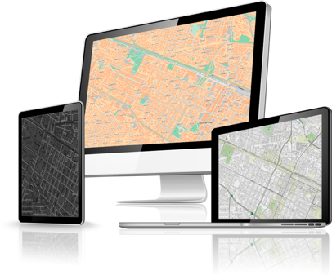
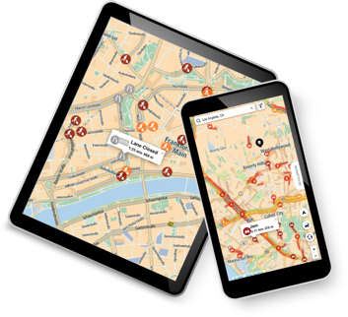
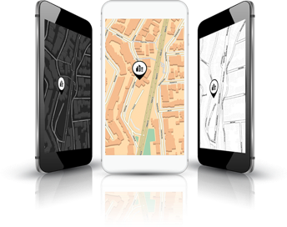
Free maps & traffic tiles on mobile via SDKs.
TomTom Traffic:
5 billion traffic measurements a day
Services
2,500 free calls per day.
EV Service:
45,000+ EV charging stations globally
Android, iOS and Javascript SDKs
TomTom Speed Cameras:
95,000+ fixed locations globally
developer.tomtom.com

Slide 7
The APIs
Notes:
About 2 years ago we decided to innovate the market by providing access to our APIs to software developer wanting to add Location to their apps. First we created REST APIs to access them, and then we put them in the cloud.

Slide 8
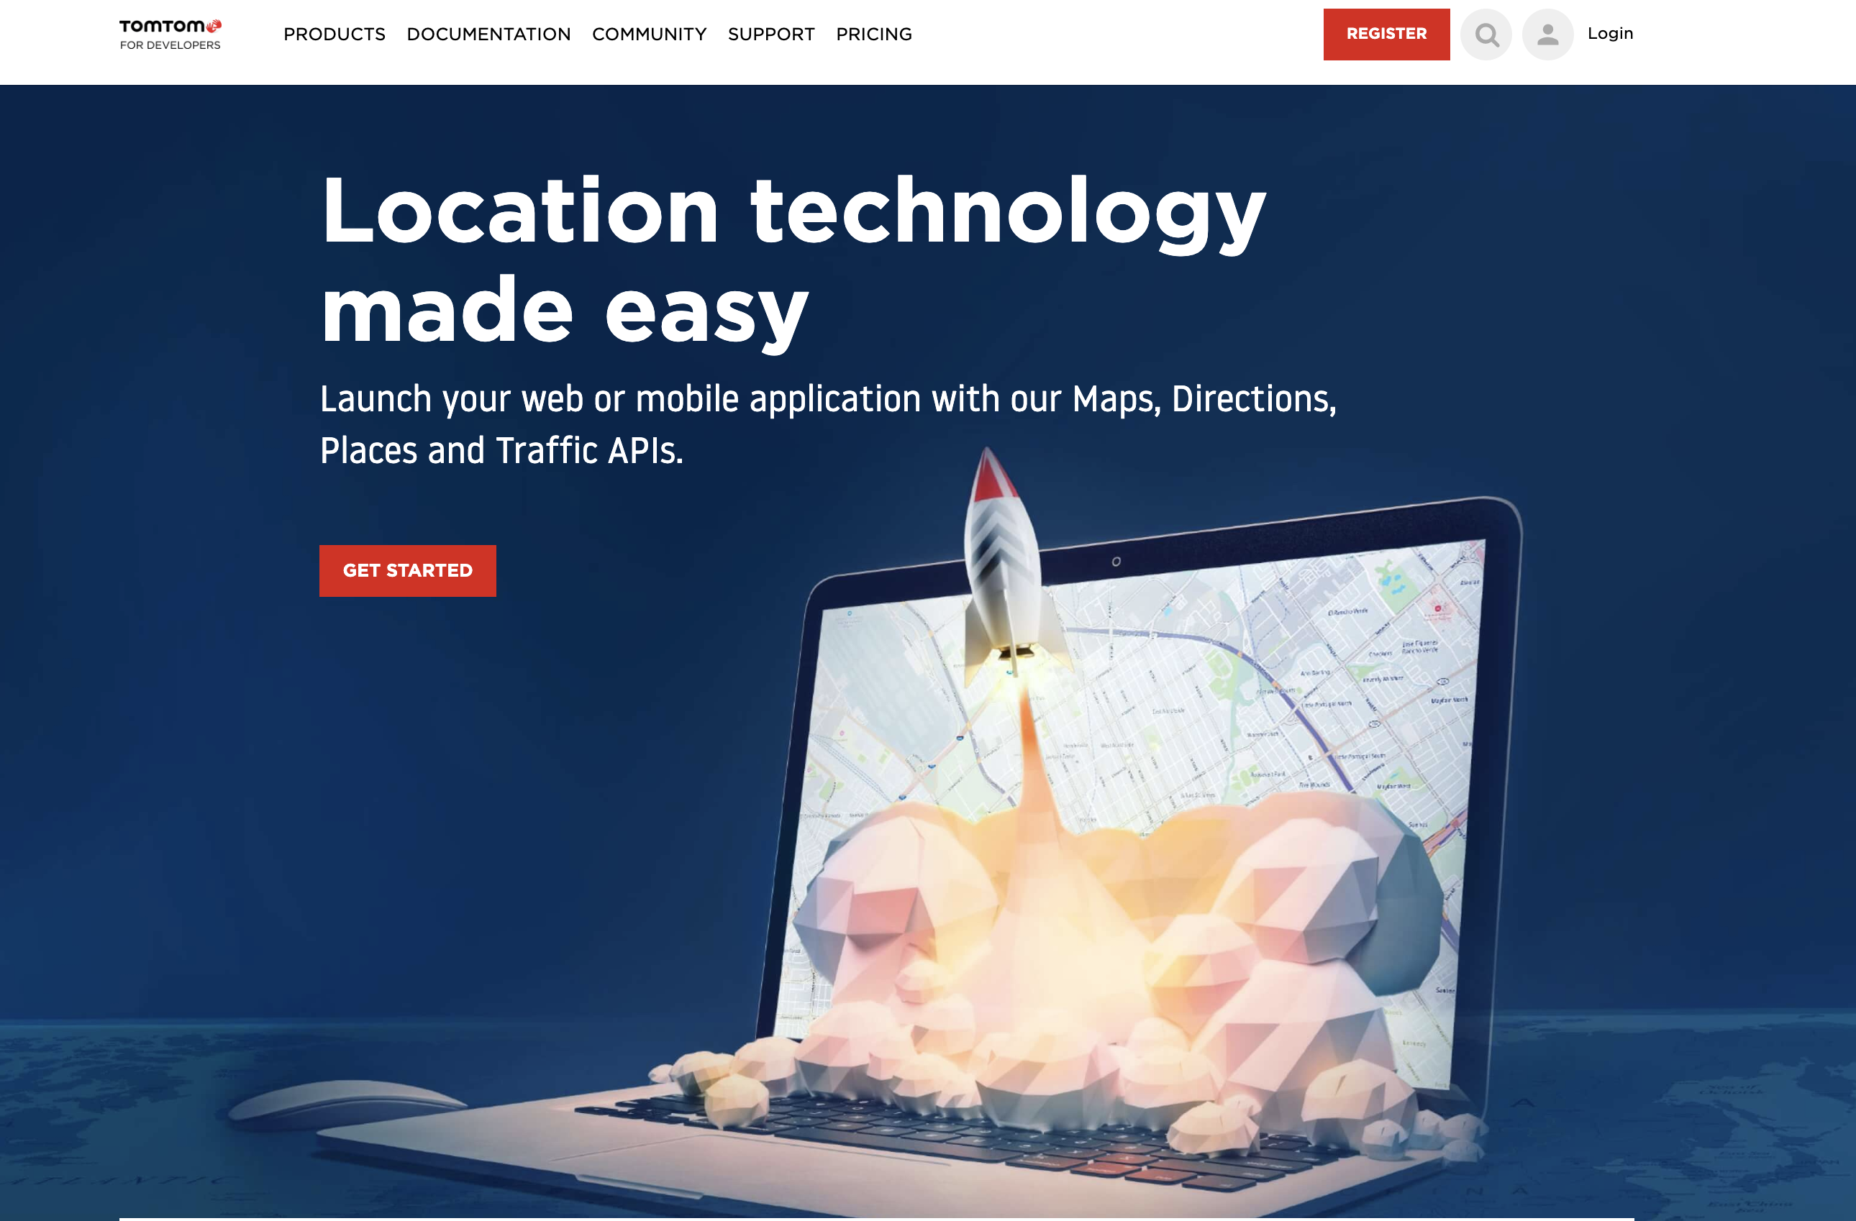
developer.tomtom.com

Slide 9
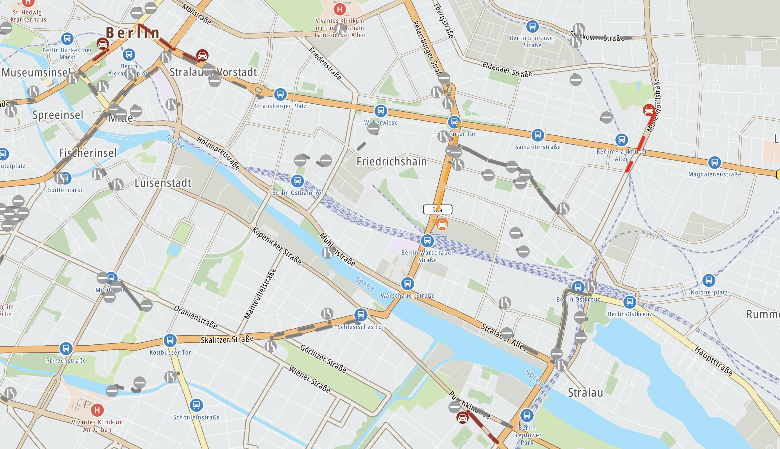
MAPS
API
https://developer.tomtom.com/content/maps-api-explorer

Slide 10
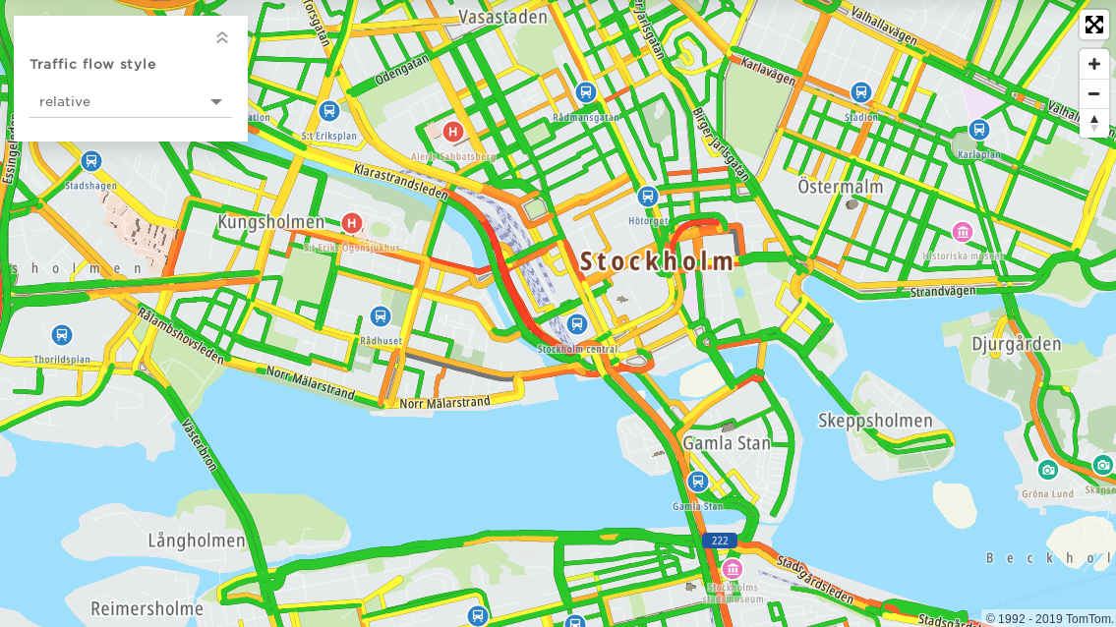
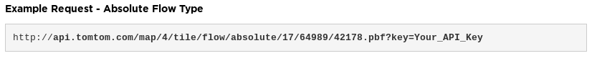
TRAFFIC
API
https://developer.tomtom.com/traffic-api/traffic-api-documentation

Slide 11
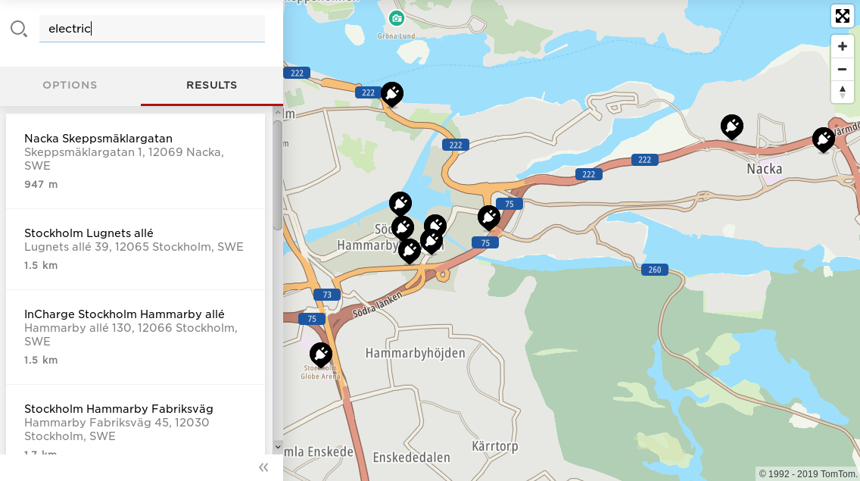
SEARCH
API
https://developer.tomtom.com/search-api/search-api-documentation

Slide 12
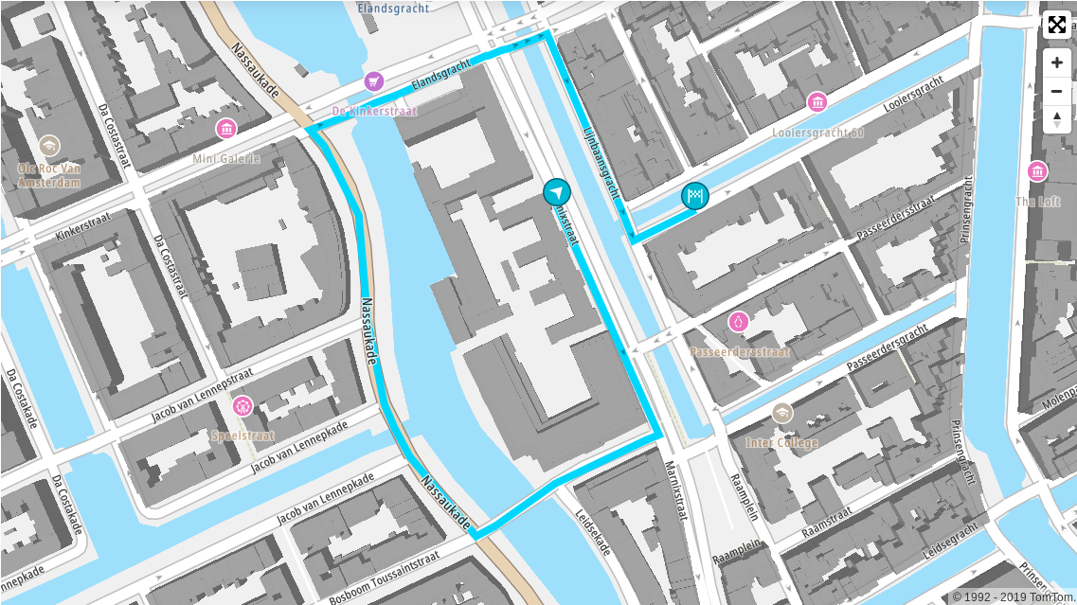
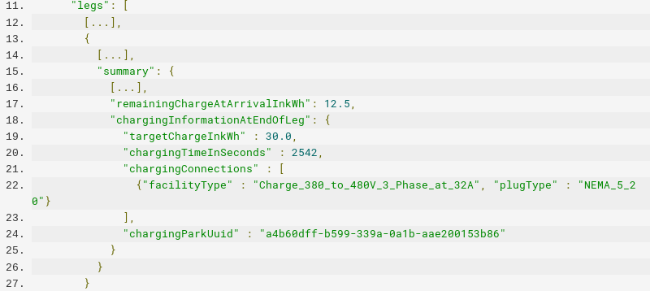
ROUTING
API
https://developer.tomtom.com/routing-api/routing-api-documentation

Slide 13
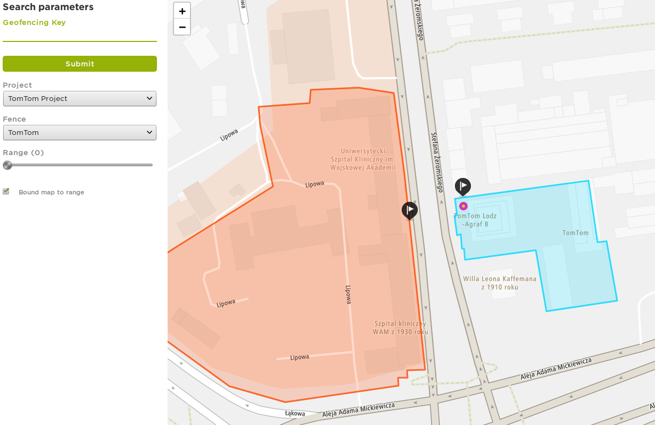
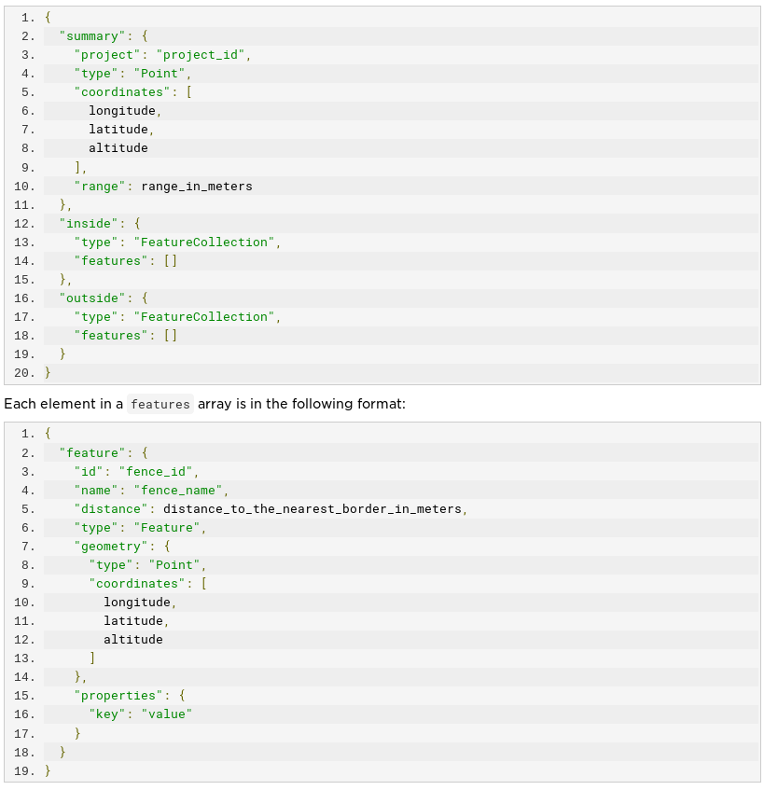
GEOFENCING API
https://developer.tomtom.com/geofencing-api/geofencing-api-documentation
https://developer.tomtom.com/geofencing-api/tutorials/fence-creation

Slide 14

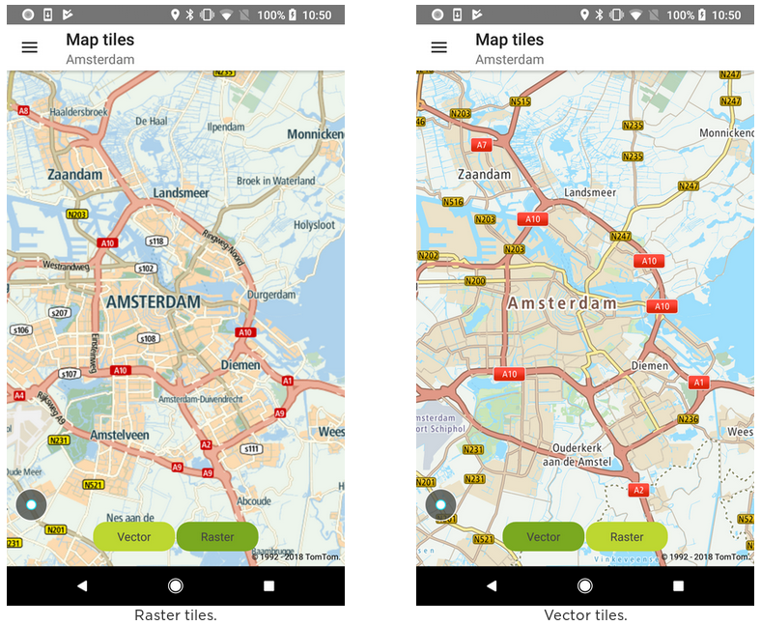
ANDROID
IOS
WEB
Kotlin, Java, Swift, ObjC, JavaScript

Slide 15
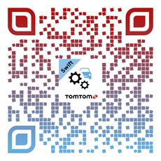
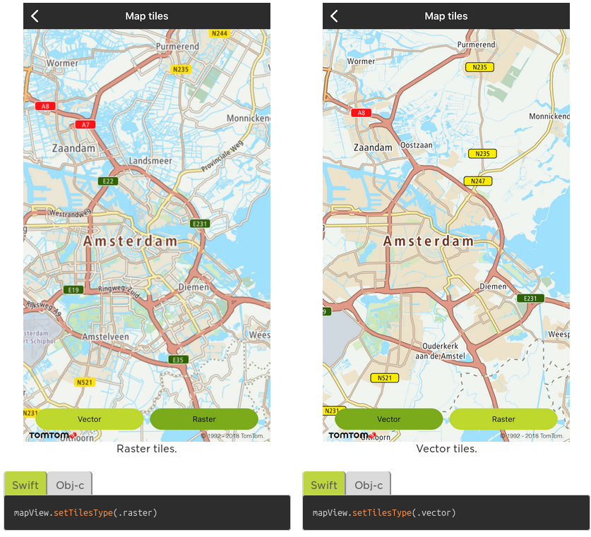
ANDROID
IOS
WEB
Kotlin, Java, Swift, ObjC, JavaScript

Slide 16

developer.tomtommaps.com

Slide 17
Thank you !
Find us! We are around and in our Booth!
developer.tomtom.com

